Slide 1
Custom Matlab Functions
Week 10 Day 38

Slide 2
Custom Functions
Function must be the only code in that script file (m-file)!
Syntax for function:
function [ output_args ] = name( input_args )
statements
end
Example:
function [ x,y,z ] = my_calc( a,b,c )
x=a+b+c;
y=a^2+b^2+c^2;
z=a^3+b^3+c^3;
end
Example function must be saved as my_calc.m
Function’s m-file name must match the function name EXACTLY!
Notes:
Note that this syntax is different from VBA in several ways. More than one argument can be sent and more than one argument can be output.

Slide 3
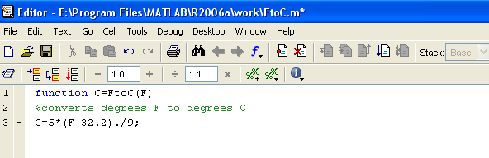
Example Function Syntax
Type this in command window; replace F with arguments
Define what C is
*When you save this M-file, give it the same name as what is on the right-hand side of the =

Slide 4
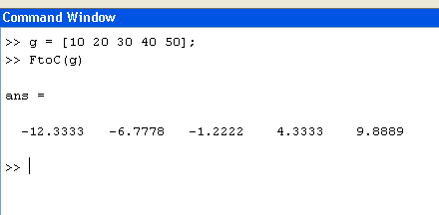
Calling the Example Function (either in command window or script file)
These values from the variable g will be the arguments (plugged in for F)
Type the name of the function on a command line and insert g in place of F
Notice that even though our function FtoC(F) has only one argument, Matlab will accept an array as that argument and the calculation will be performed on each element of the array and the output will be a corresponding array!

Slide 5
In-Class Exercise #5
Create a custom function which returns both the mean and standard deviation of an array
Your function should be called PSWCStats(x)
Use the Matlab built-in functions for your calculation

Slide 6
“Anonymous” Functions
If you want to define a small custom function just for use within one script file, you can use an “anonymous” function
Syntax:
functionname = @(arguments) formula;
Example:
parabola = @(x) a*x.^2 + b*x + c;

Slide 7
Plotting Functions
Matlab allows you to skip creating an array of data points and plot any built-in or defined (function .m file or anonymous) function
Syntax:
fplot(functionname, [limits], ‘linespec’)

Slide 8
In-Class Exercise #6
Write a Matlab script which defines the anonymous function “parabola” from the previous slide
Plot the function “parabola” from x=-10 to x=10 for values of a, b, c = 2, 1, -2, using fplot

